Slide 1
Configurable Neuromorphic Network-on-Chip Architecture for Spiking Neural Networks
Final Presentation
R.M.T.N.K RATHNAYAKA
Notes:
Presentations are limited to 15 minutes, which will be followed by a 10 minutes viva session by the examiners.
Please be ready to present on;
>> Background to the problem
>> Methodology conduct to solve the problem
>> Experiments & Findings
>> If problems encountered, how they were handled
>> Plan to complete the research work
>> Expected outcomes, deliverables and their impact.
Evaluation Criteria;
1. Problem/Solution: Clear understanding of the research problem and the solution
2. Progress: Current progress of the proposed study (findings and results) and any problems encountered. If problems encountered, how the challenges were handled
3. Plan to complete the remaining work, up to completing paper
4. Presentation skills: Clarity of the presentation, logically structured flow, proper use of presentation aids, clarity and completeness of answers, etc

Slide 2
Table of Contents
01 Introduction
02 Background
03 Methodology
04 Experiments
05 Findings
06 Achievement of Project Objectives

Slide 3
01
Introduction

Slide 4
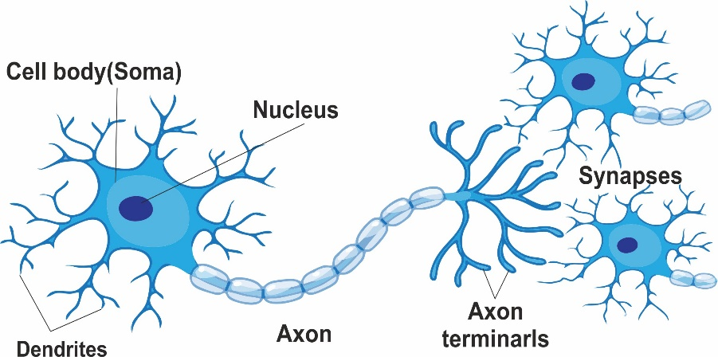
INTRODUCTION
What is a Neuron?
A neuron is a specialized cell in the brain that processes and transmits information through electrical and chemical signals, forming the basis of all cognitive functions

Slide 5

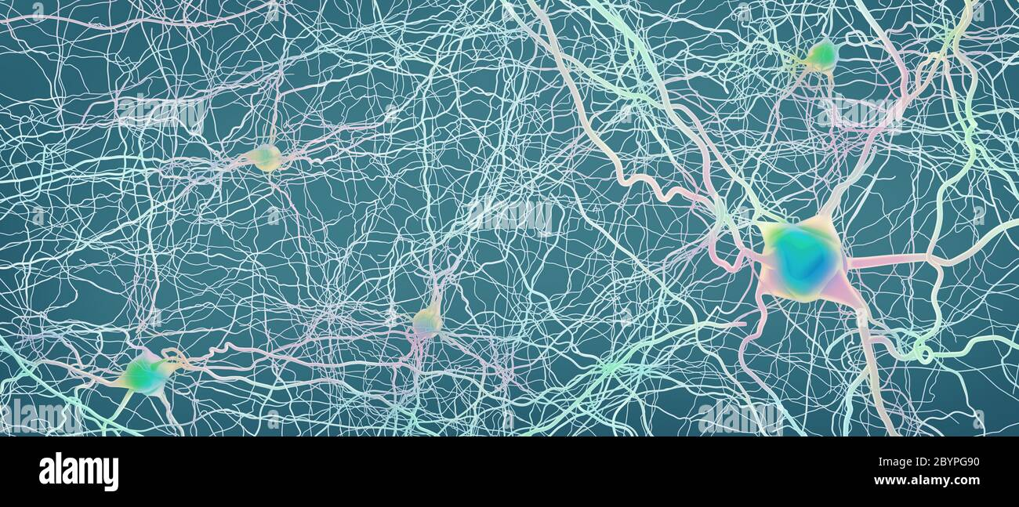
INTRODUCTION
What is a Neural Netwok?
Complex interconnected system of neurons in the nervous system of animals, including the human brain, that work together to process and transmit information through electrical and chemical signals

Slide 6


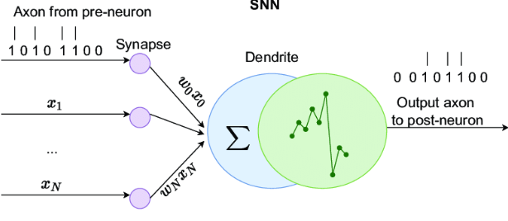
INTRODUCTION
What is a Artificial Neuron?
An artificial neuron mimics the behavior of biological neurons, processing inputs through weights and biases to produce an output, forming the building block of neural networks.

Slide 7
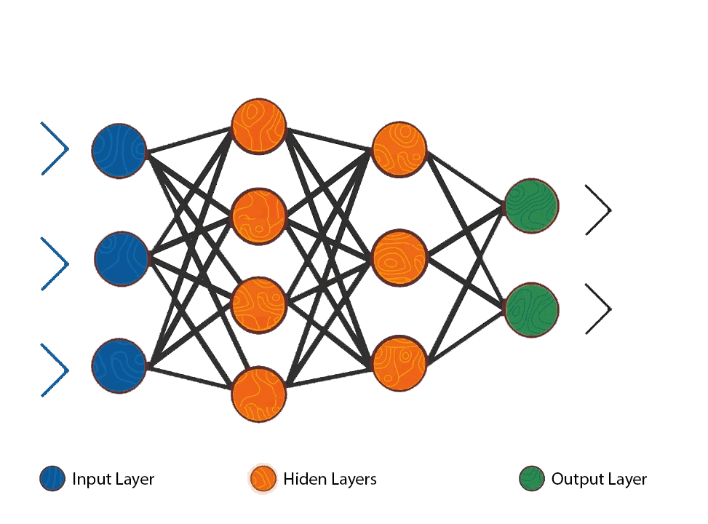
INTRODUCTION
What is a Artificial Neural Network?
Computational model composed of interconnected artificial neurons, designed to learn and perform tasks by adjusting weights through training, inspired by the structure and function of biological neural networks

Slide 8
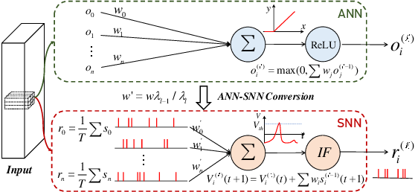
INTRODUCTION
What is a Spiking Neuron
A computational model that simulates the behavior of biological neurons more closely by considering the timing and frequency of individual spikes

Slide 9
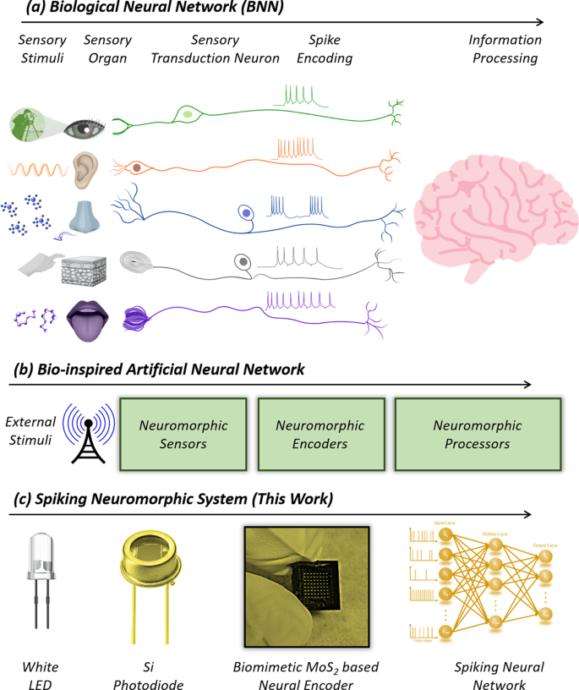
INTRODUCTION
What is a Spiking Neuron

Slide 10

Spiking Neuron networks
Spiking neural networks introduce a more biologically accurate approach by modeling the timing of neuron spikes, potentially enhancing temporal information processing compared to traditional artificial neural networks,

Slide 11
The Problem with SNNs
Asynchronous behaviour
Neuron models are more complex
Not very power efficient
Traditional CPU/GPU hardware is not sufficient
There is a growing need for specialised architectures purpose-built for SNNs that are scalable and configurable

Slide 12
INTRODUCTION
What is Neuromorphic Engineering?
Neuromorphic computing is an approach to computing that uses hardware and software inspired by the principles of the human brain.
The goal of neuromorphic computing is to develop computers that can perform complex tasks with energy efficiency and robustness similar to that of biological neural networks.
Compared to traditional architecture, neuromorphic computing offers potential advantages such as lower power consumption, faster processing, and more efficient use of memory
12

Slide 14
02
Background

Slide 15
Existing Architectures
General-purpose
Application-specific
Notes:
There is a lack of designs that exploit the programming flexibility and platform maturity of existing architectures
Highly-specialised hardware offers great performance, but are fairly rigid in their design
We are attempting to bridge the gap by demonstrating that an existing ISA can be augmented to perform SNN simulation in a scalable and configurable manner

Slide 16
Existing Architectures
High Overhead
General-purpose
SpiNNaker
(APT Research Group, Department of Computer Science, University of Manchester)
DYNAP
(Moradi, S. et al.)
Notes:
There is a lack of designs that exploit the programming flexibility and platform maturity of existing architectures
Highly-specialised hardware offers great performance, but are fairly rigid in their design
We are attempting to bridge the gap by demonstrating that an existing ISA can be augmented to perform SNN simulation in a scalable and configurable manner

Slide 17
Existing Architectures
OpenSpike
(Modaresi, F. et al.)
Zhang, J. et al.
Low Flexibility
Application-specific
Notes:
There is a lack of designs that exploit the programming flexibility and platform maturity of existing architectures
Highly-specialised hardware offers great performance, but are fairly rigid in their design
We are attempting to bridge the gap by demonstrating that an existing ISA can be augmented to perform SNN simulation in a scalable and configurable manner

Slide 18
Our Contribution
High Overhead
General-purpose
Our Design
Low Flexibility
Application-specific
Notes:
There is a lack of designs that exploit the programming flexibility and platform maturity of existing architectures
Highly-specialised hardware offers great performance, but are fairly rigid in their design
We are attempting to bridge the gap by demonstrating that an existing ISA can be augmented to perform SNN simulation in a scalable and configurable manner

Slide 19
03
Methodology

Slide 20
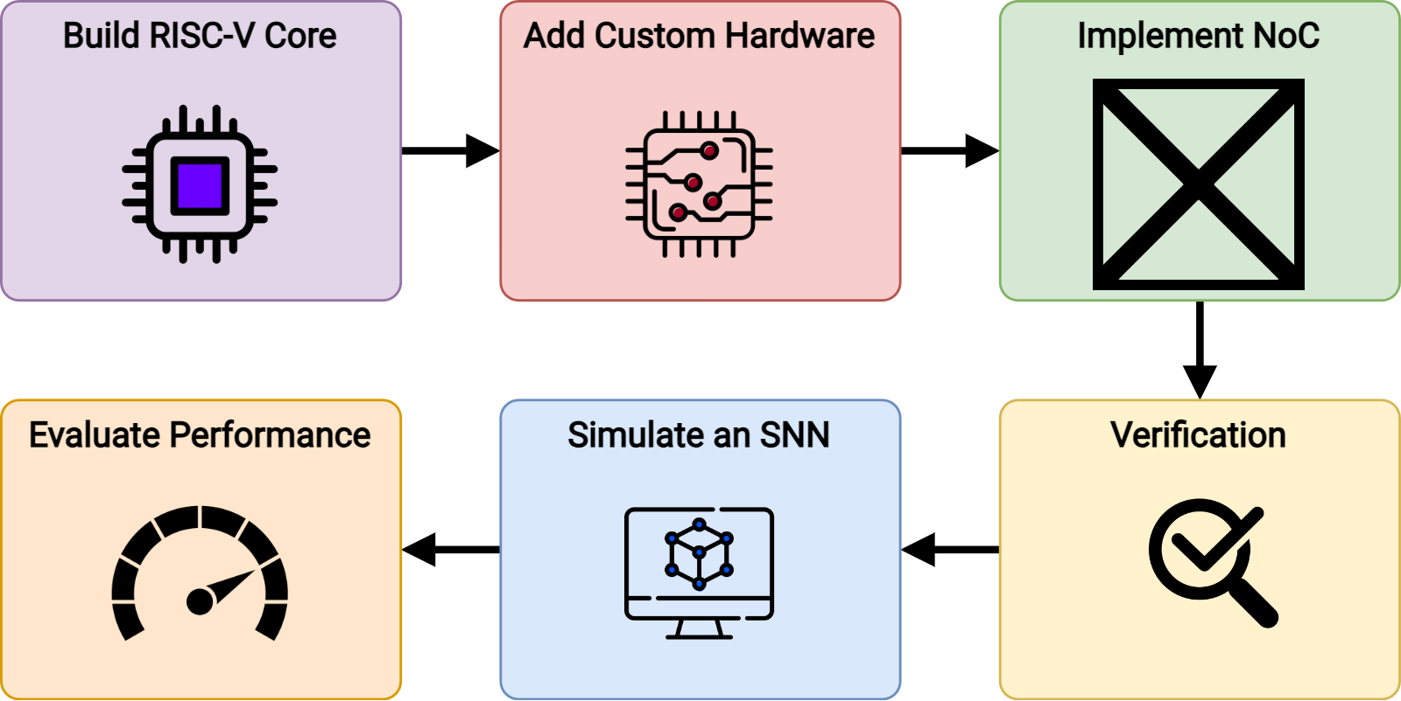
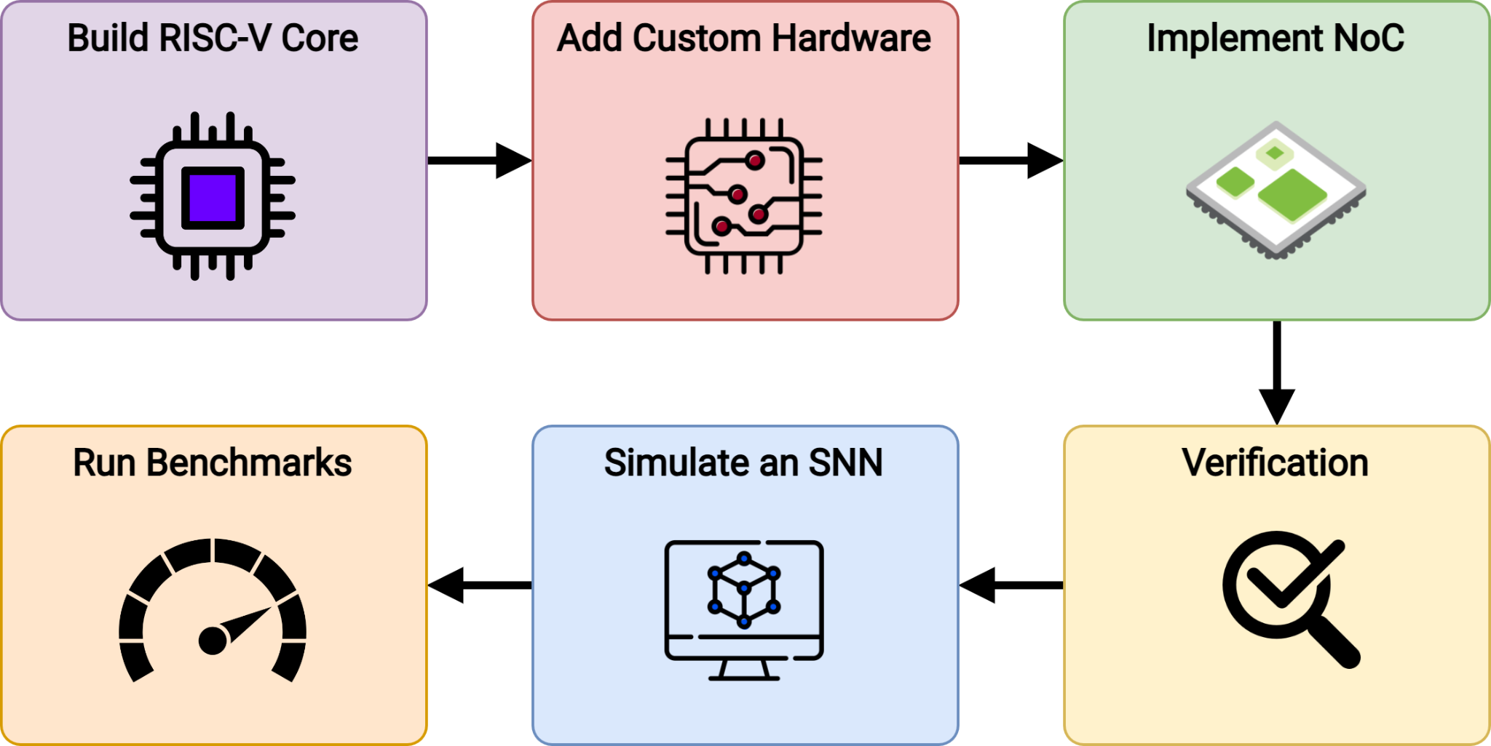

Slide 21
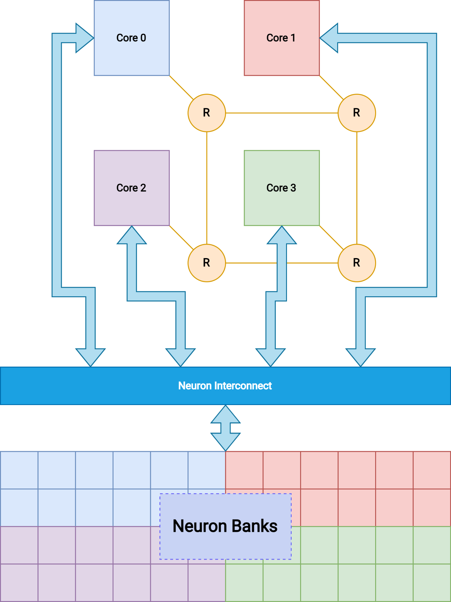
Overall Architecture
Neuron Configuration
NoC
Spike Resolution
Neuron State Update
Neuron Banks
After-Spike Reset

Slide 22
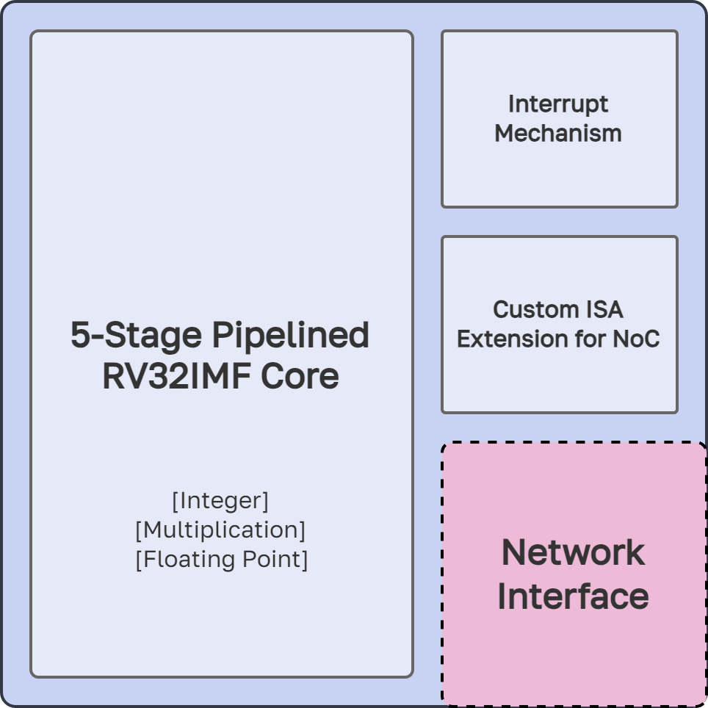
The Core
Notes:
A 5-stage pipelined RV32IMF core
Random Number Generator to provide the random number seed for SNN computations
Custom interrupt mechanism to facilitate event-driven messaging
Custom ISA extension for software-level handling of NoC communication

Slide 23
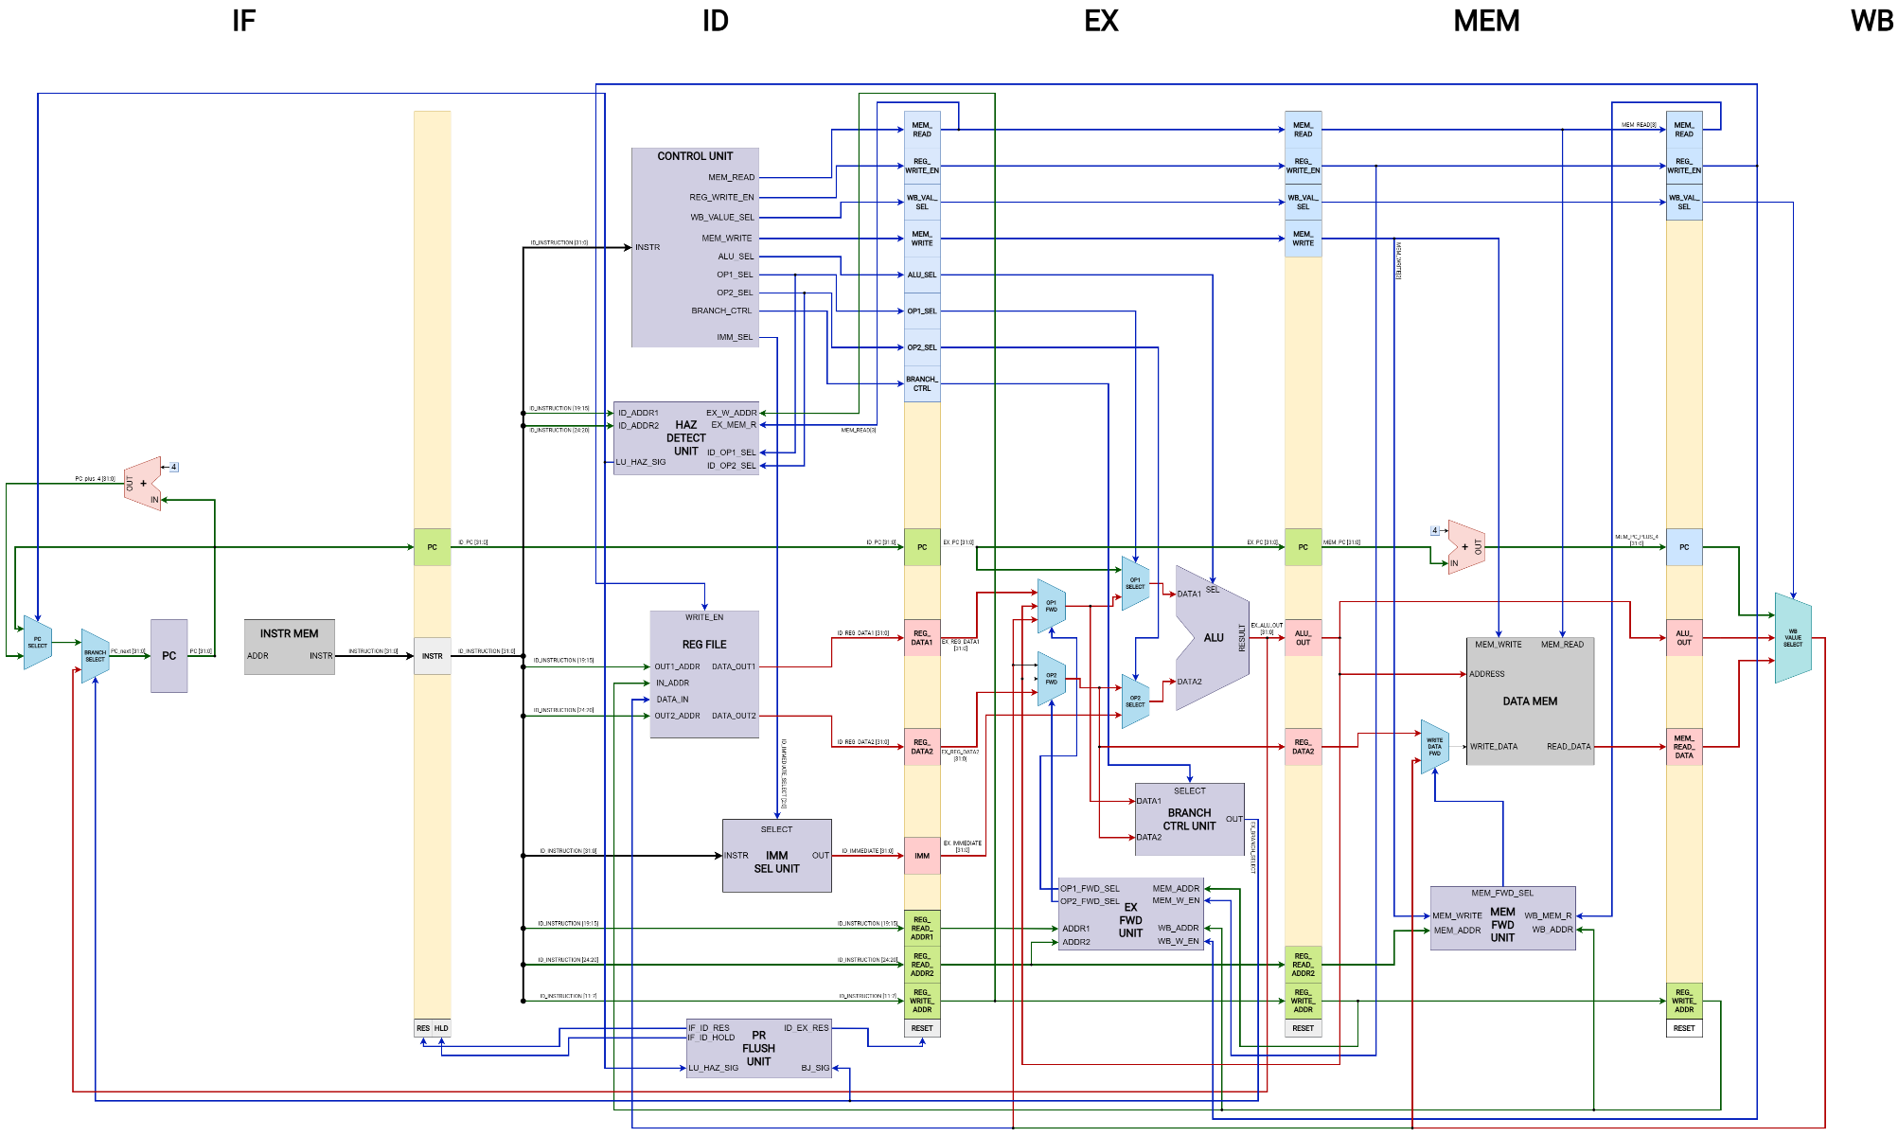

Slide 24
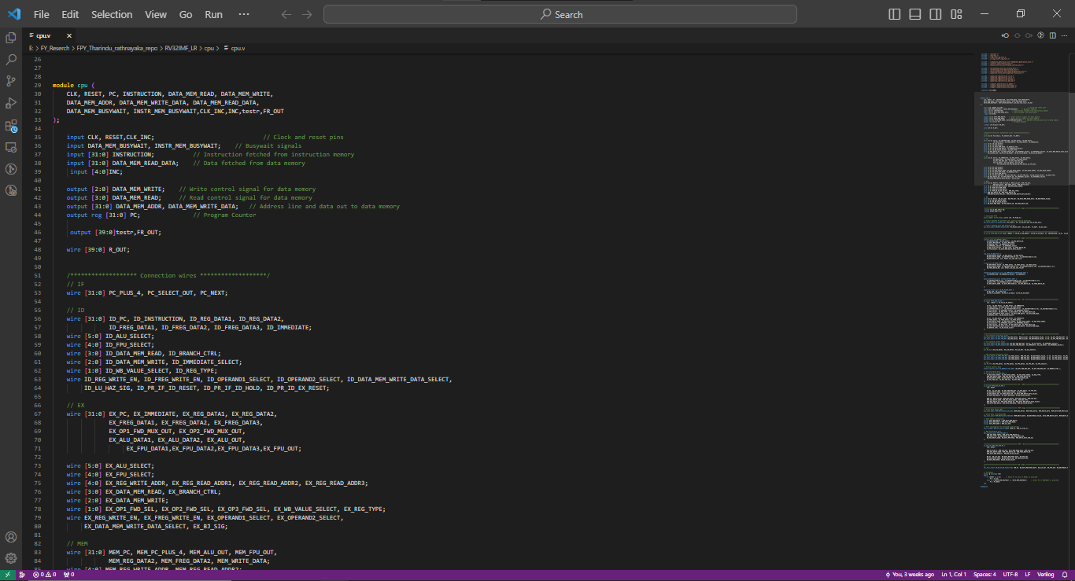

Slide 25
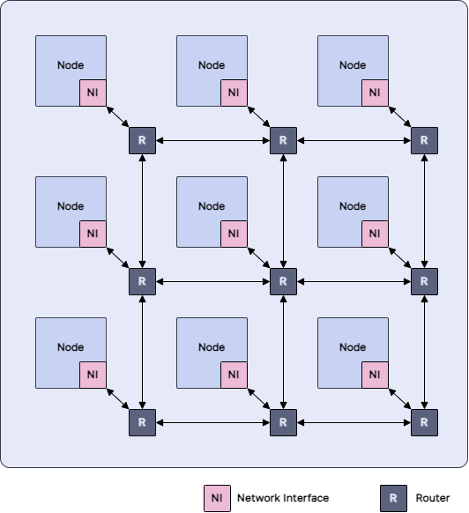
The NoC
Customised RISC-V Core
Router
FIFO Network Interface
Network-on-Chip
Notes:
Uses RISC-V as the base Instruction Set Architecture (ISA)
Extends the ISA with custom instructions as well as custom hardware needed for our application
Network-on-Chip architecture allows for high degree of parallelism and scalability
Uses the Izhikevich neuron model
Will be tested and benchmarked on an FPGA

Slide 26
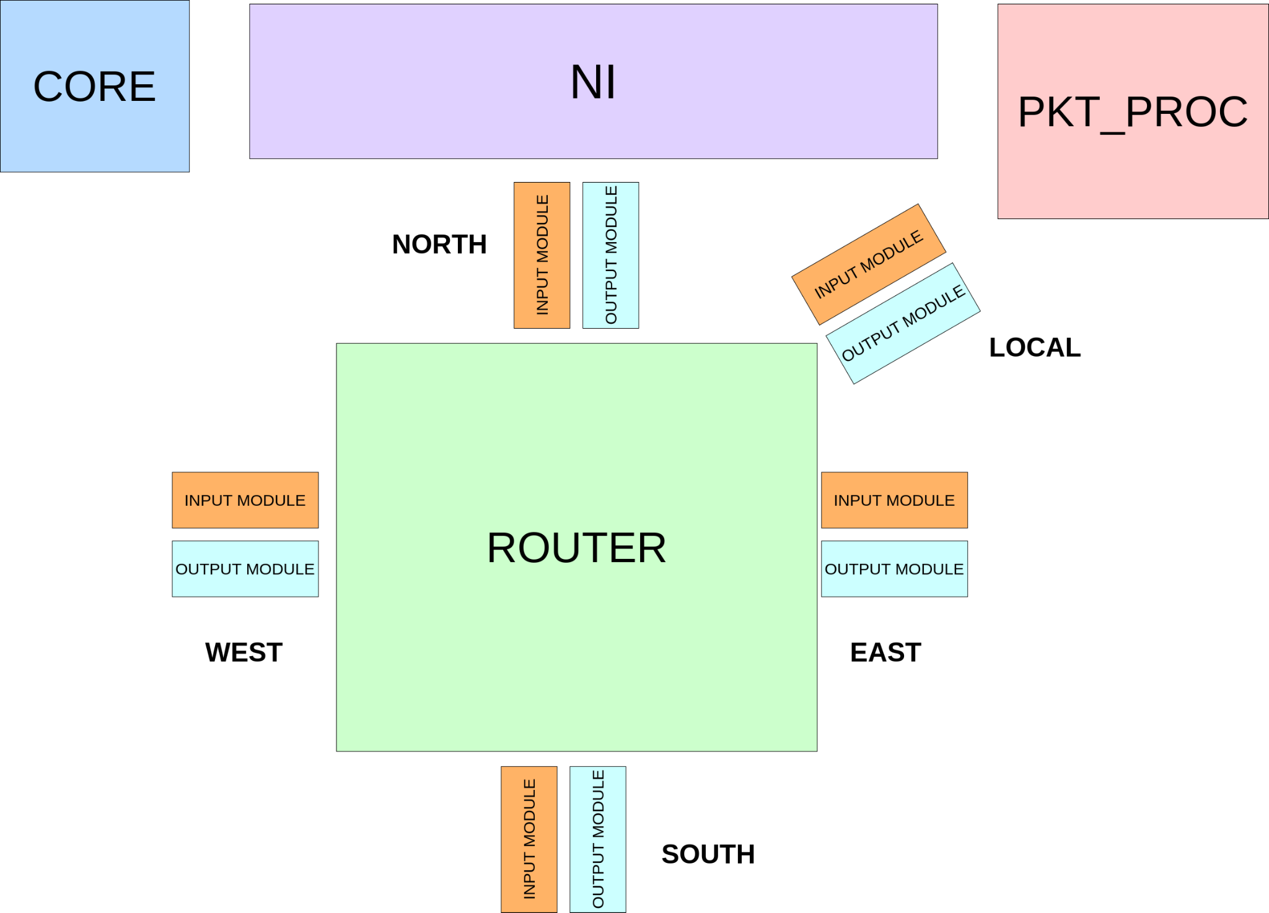
The NoC

Slide 27
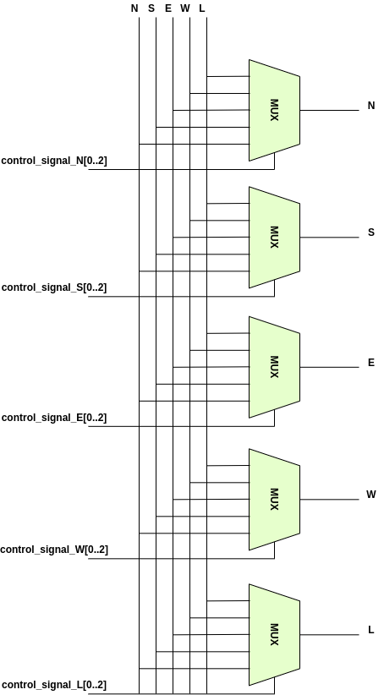
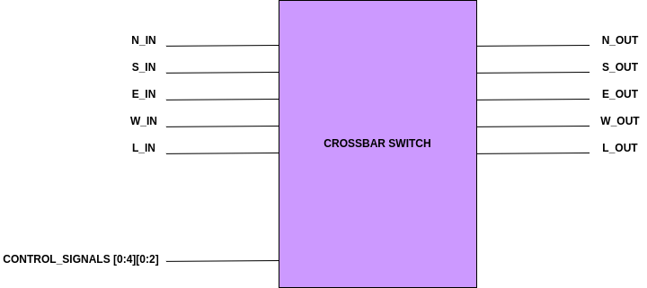
Router

Slide 28
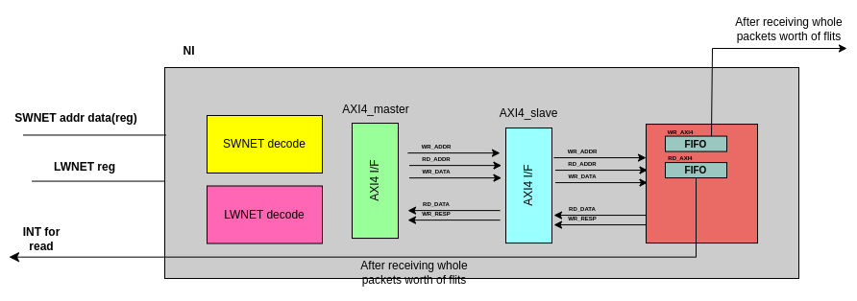
Network Interface

Slide 29
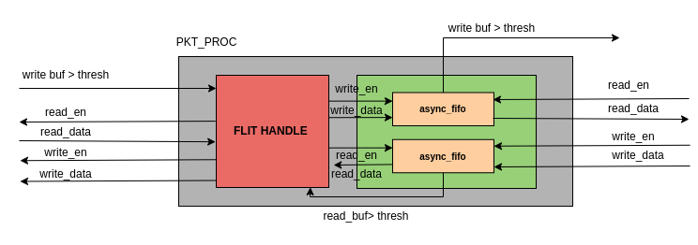
PKT_PROC

Slide 30
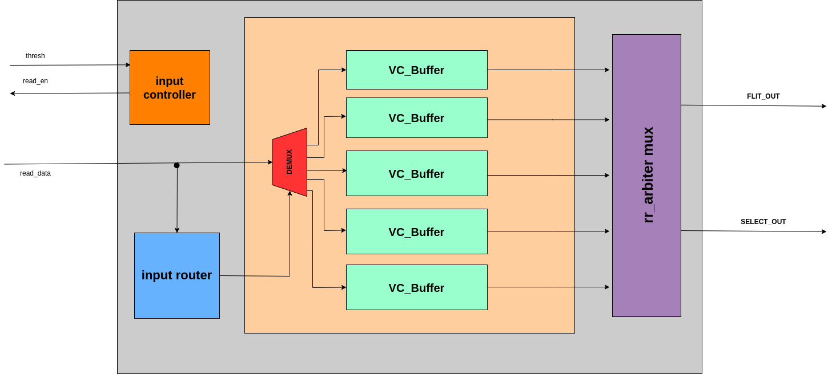
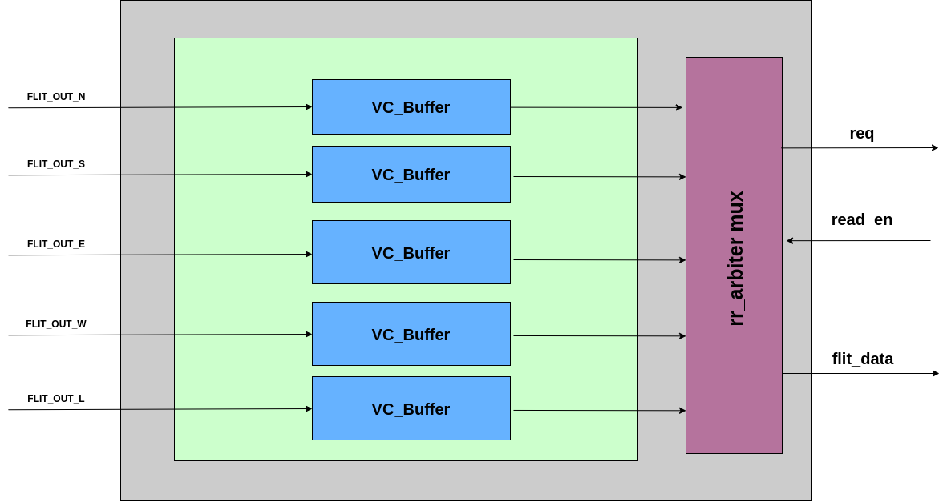
INPUT / OUTPUT MODULES

Slide 31
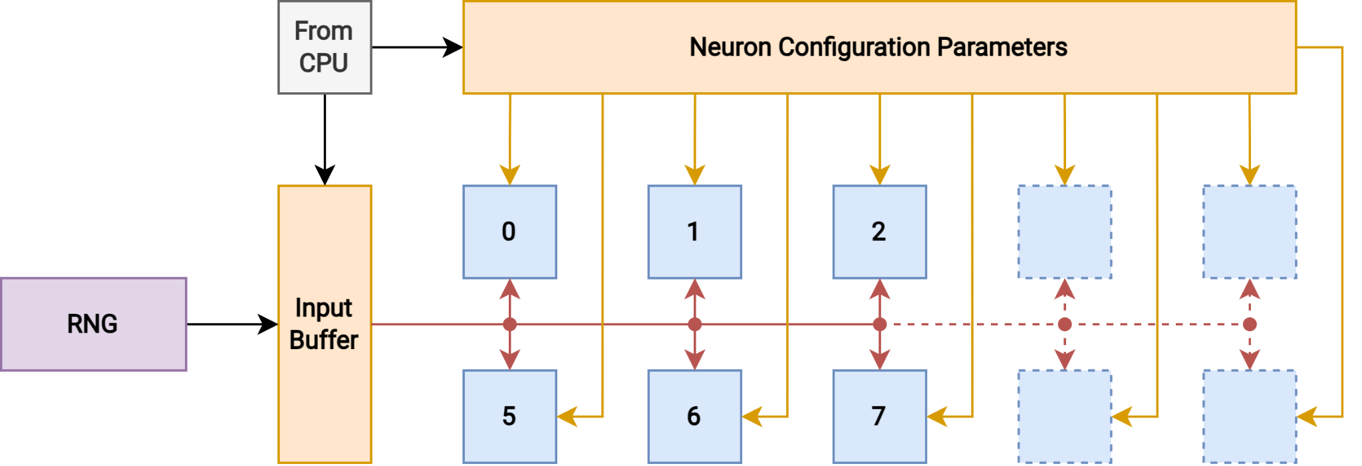
Neuron Banks

Slide 32
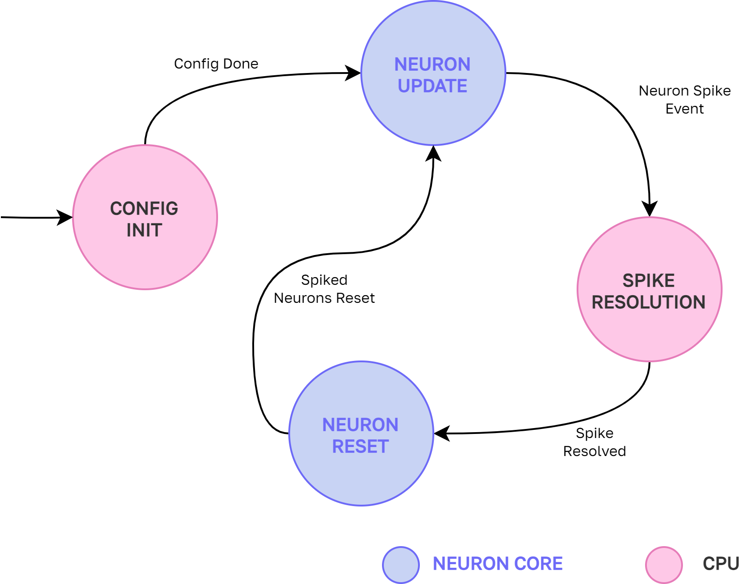
Final Architecture

Slide 33
03
Varification

Slide 34
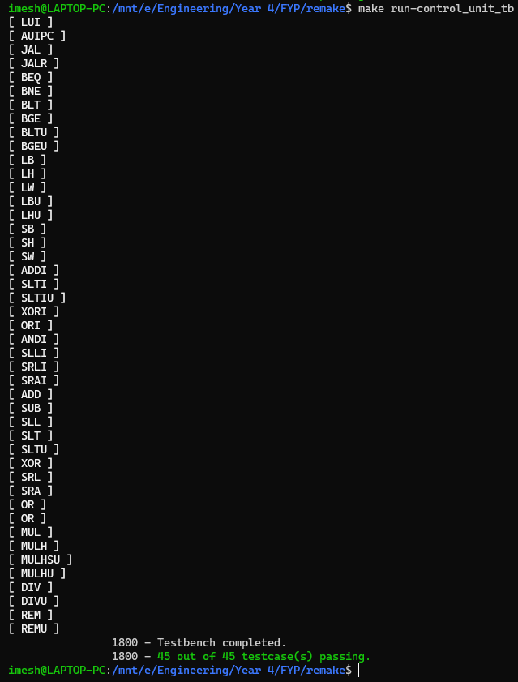
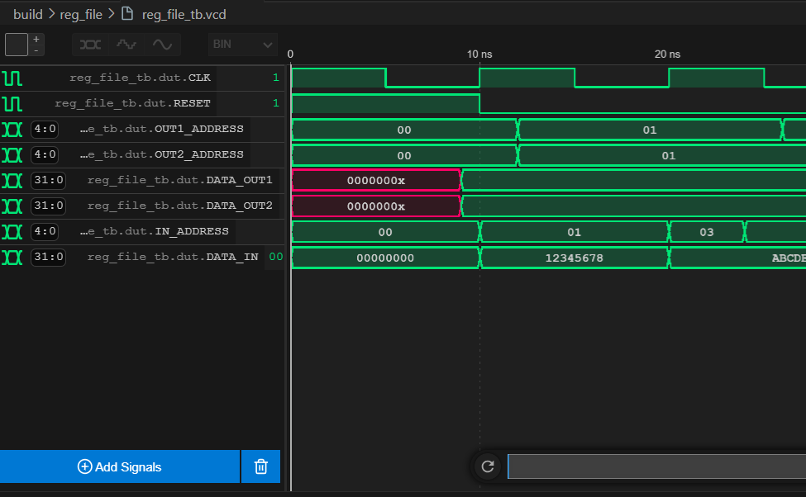
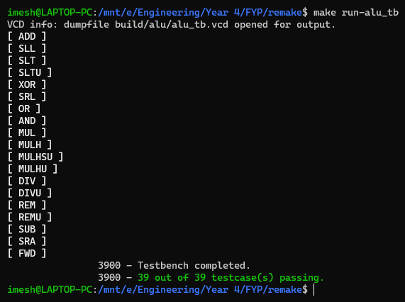
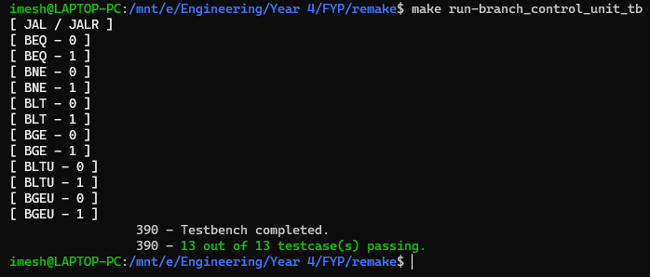
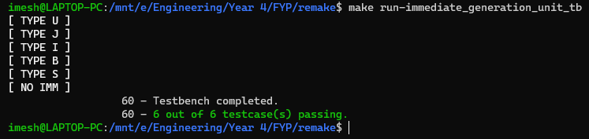
Verification - Software Simulations

Slide 35
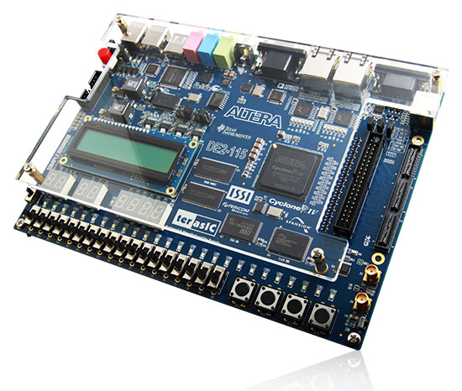
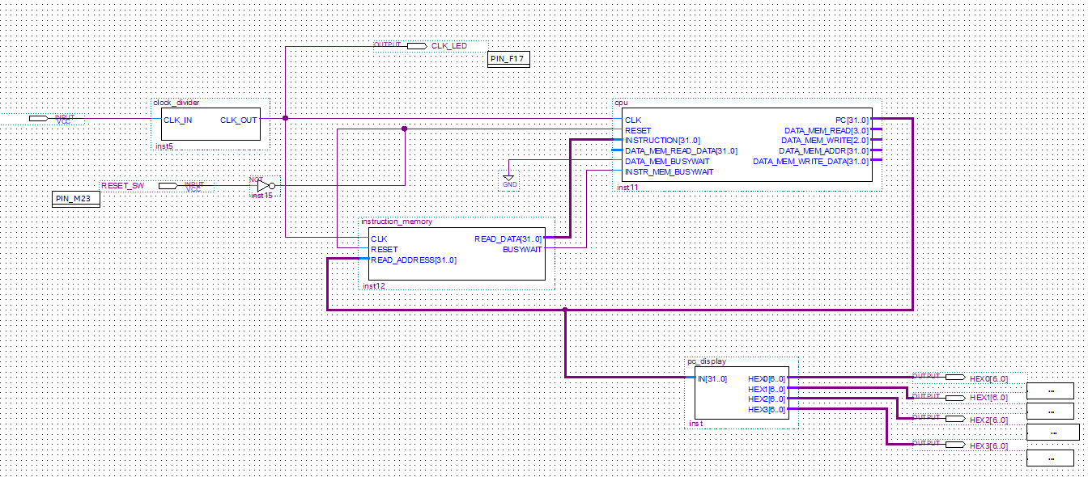
Verification - Hardware Testing

Slide 36
04
Experiments

Slide 37
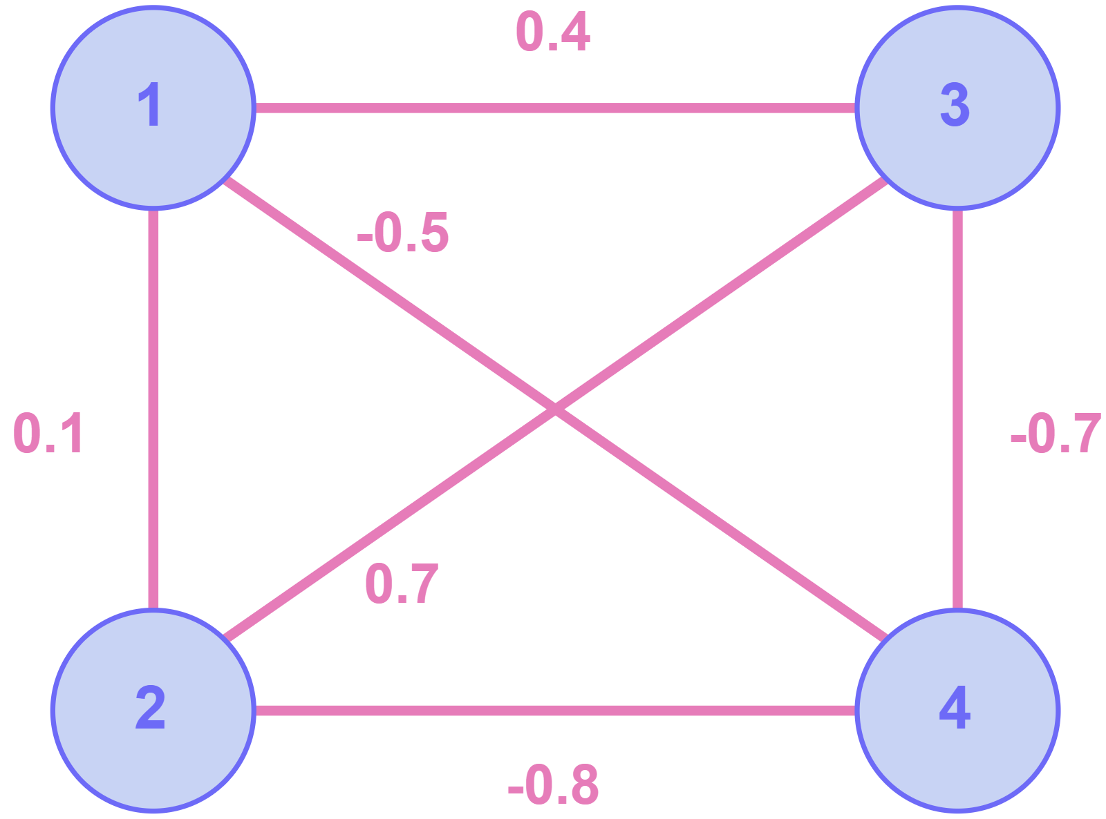
Setup
Sample SNN with four neurons
Simulated on FPGA hardware
Three different configurations
Single RISC-V Core
Two-Core NoC
Two-Core NoC + Neuron Banks
Measured clock cycles taken to execute 1s of the simulation (1ms timesteps)
Notes:
Setting up for operation

Slide 38
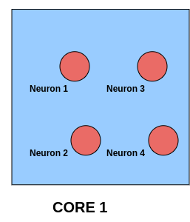
Experiment I: Single Core
Notes:
Setting up for operation

Slide 39
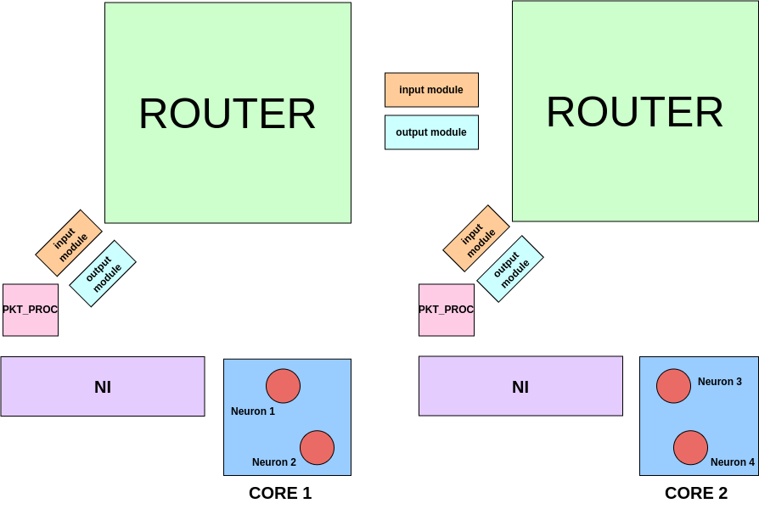
Experiment II: 2-Core NoC
Notes:
Setting up for operation

Slide 40
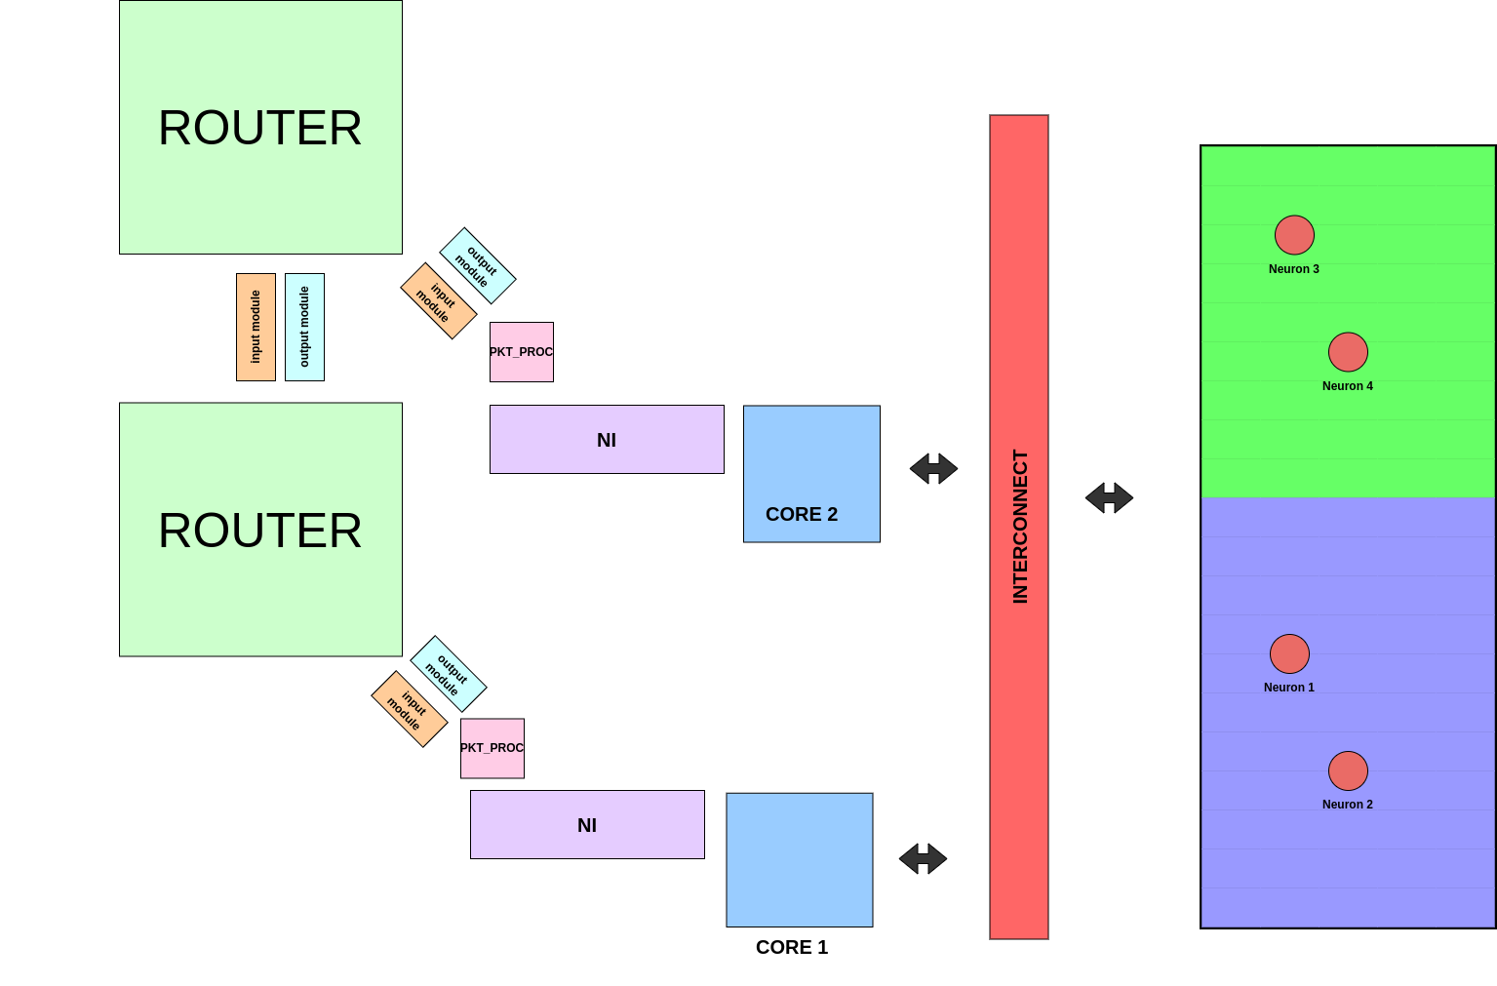
Experiment III: 2-Core NoC + Neuron Banks
Notes:
Setting up for operation

Slide 41
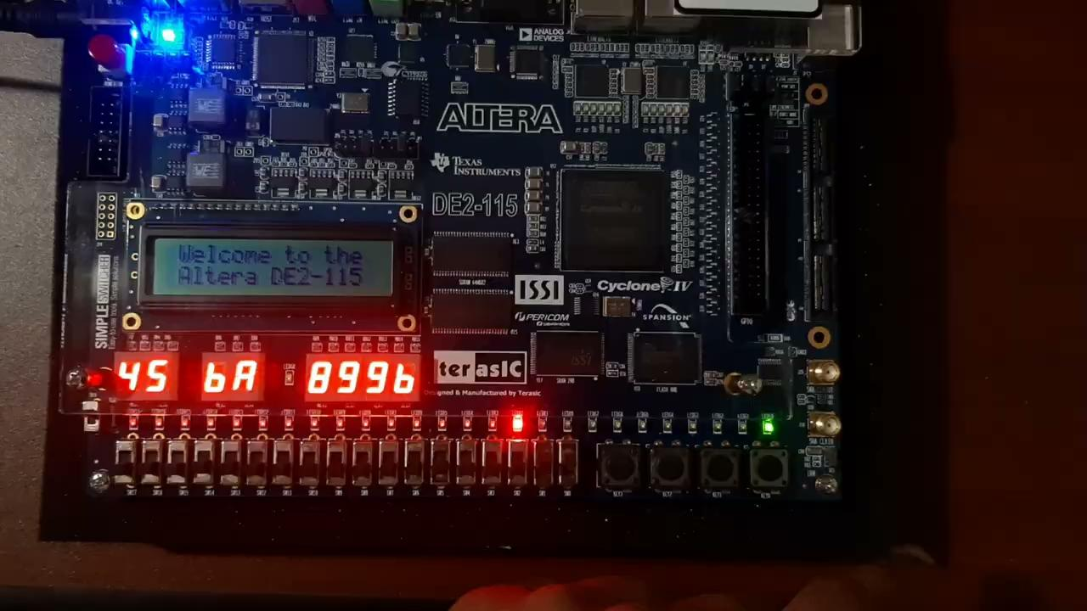

Slide 42
05
Findings
Notes:
Comparison of performance

Slide 43
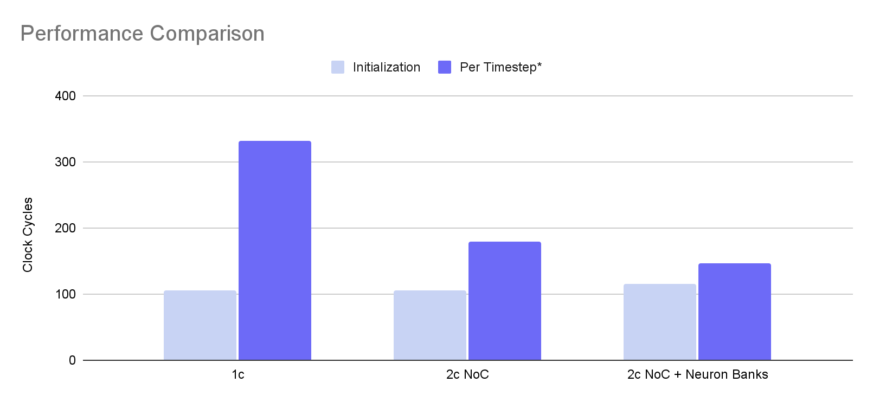
Results
[*] No. of clock cycles for a 1ms timestep of the SNN simulation
Notes:
Timing comparison →
Random Number Generator to provide the random number seed for SNN computations
Custom interrupt mechanism to facilitate event-driven messaging
Custom ISA extension for software-level handling of NoC communication

Slide 44
Scalability
In the 2C NoC scenario, scalability is limited by register space in the CPU
Scalability is improved by offloading the work to specialised neuron cores
Added initialization latency becomes negligible at scale

Slide 45
06
Achievement of
Project Objectives

Slide 46

Project Objectives
SNN simulation on the custom design
Synthesizable custom RISC-V CPU + NoC
Testing the performance
Notes:
Working implementation of our architecture on an FPGA
Demonstration of an SNN simulation running on a NoC with multiple cores
Benchmarking and testing the performance using simplified versions of standard benchmarks such as NEST and Brian2

Slide 47
Potential Improvements
Out-of-order execution on the RISC-V core
Spike resolution algorithm improvements
Programming abstractions
Notes:
Working implementation of our architecture on an FPGA
Demonstration of an SNN simulation running on a NoC with multiple cores
Benchmarking and testing the performance using simplified versions of standard benchmarks such as NEST and Brian2

Slide 48
Thank You!
Any questions?

Slide 49
04
Current Progress

Slide 50
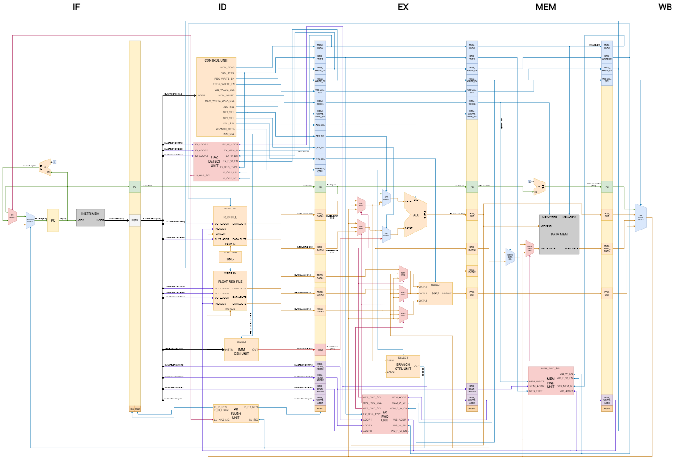
RV32IM Core
RNG
Floating Point Hardware
Hazard Handling
Interrupt Mechanism
Network-on-Chip
Programmable Neuron Banks

Slide 51
Network-on-Chip
Mesh Topology
Flit-based Flow Control with Virtual Channels
5-stage Router
LWNET and SWNET Instructions for NI Access by Core
Notes:
Mesh topology (2D x-y)
Flow control:
Switching :
Flit data width : 8 bit wide (head, body and tail)
Buffers per input module
Routing algos
Router -> 5 connections (N,S,E,W& local) each with FIFO (2 for each , 64bit wide , 32 slots, each with 32 bit address, 32 bit data)
Virtual channels (at input cnosiders priority )
LWNET and SWNET for NI access by Core

Slide 52
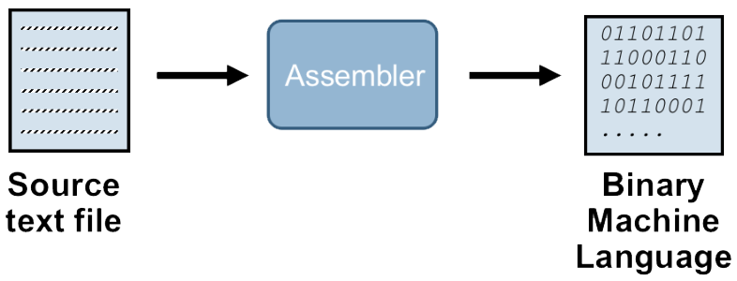
Software
Custom assembler

Slide 53
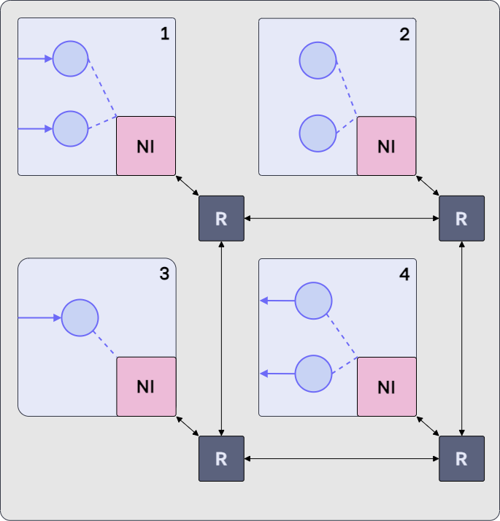
Software
SNN simulation algorithms
Neuron mapping methods

Slide 54
Challenges
FPGA license has expired.
Operated with limited functionality.
Monitoring the CPU while running on the FPGA.
Probing the CPU state using a Nios II core.
Limited background in NoC architectures.
Self-learning and researching existing architectures.

Slide 55
Instructions:
This counts for 25% of the final mark.
Presentations are limited to 15 minutes, which will be followed by a 10 minutes viva session by the examiners.
Please be ready to present on;
Background to the problem
Methodology conduct to solve the problem
Experiments
Findings
Expected outcomes, deliverables and their impact

